Slide 1
OSI Model

Slide 2
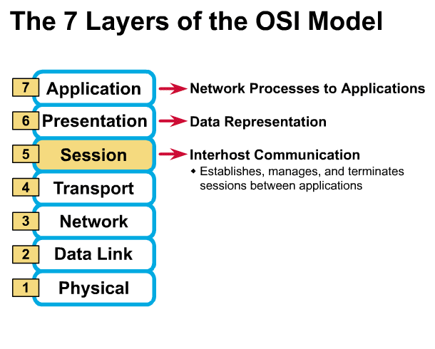
Session Layer
Allows applications to maintain an ongoing session
Manages Session
Synchronization

Slide 3
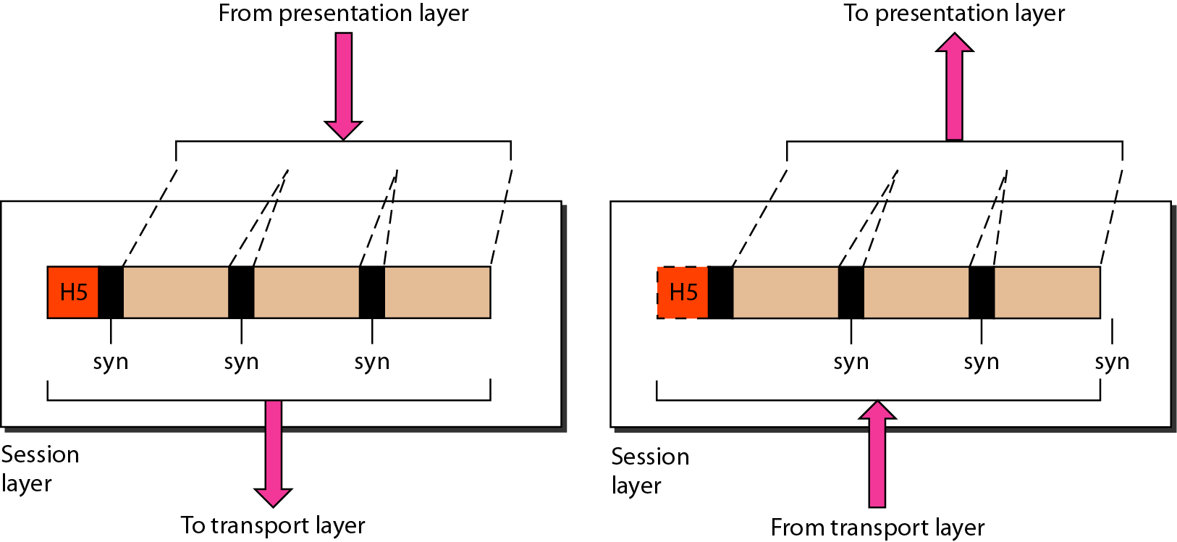
Session layer

Slide 4

Note
The session layer is responsible for dialog control and synchronization.

Slide 5
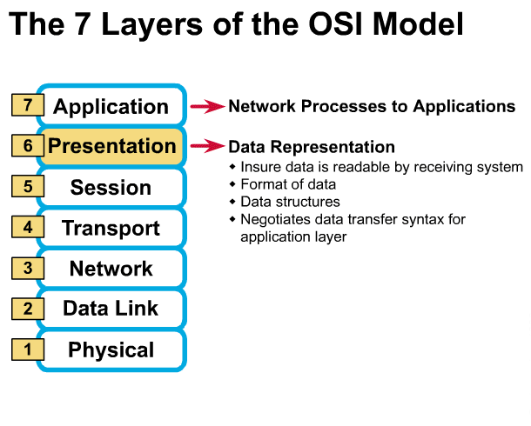
Presentation Layer
Encryption
Decryption
Compression
³

Slide 6
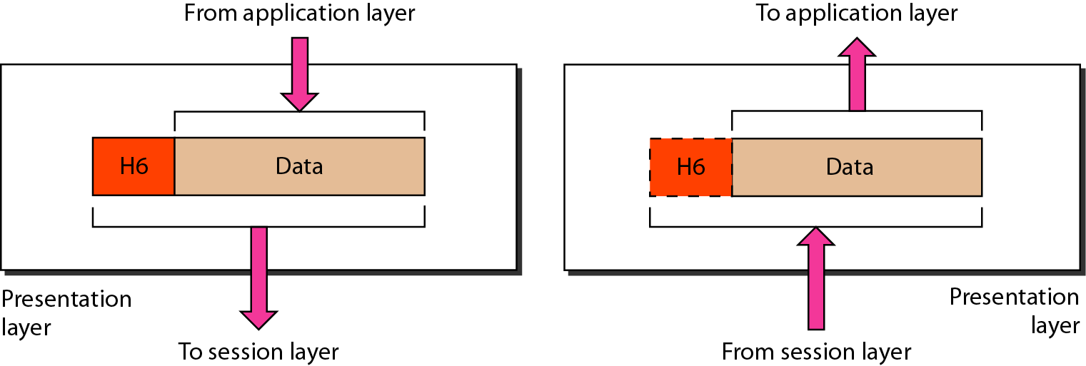
Presentation layer

Slide 7
Note
The presentation layer is responsible for translation, compression, and encryption.

Slide 8
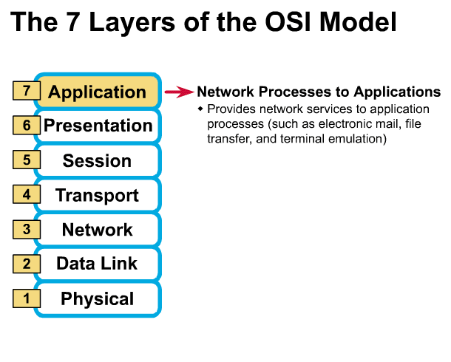
Application Layer
Gives end-user applications access to network resources
File transfer, access, management
Mail Services

Slide 9
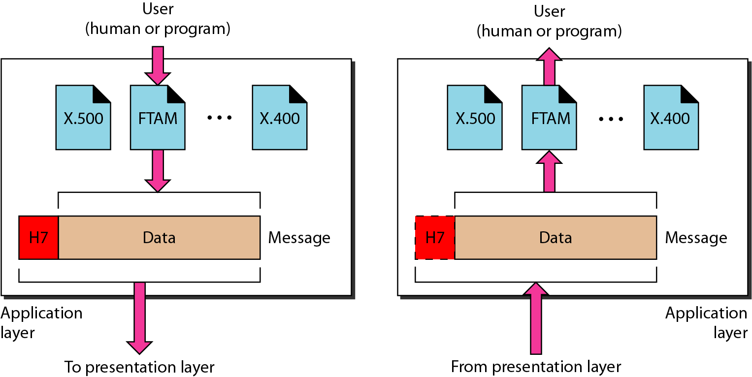
Application layer

Slide 10
Note
The application layer is responsible for providing services to the user.

Slide 11
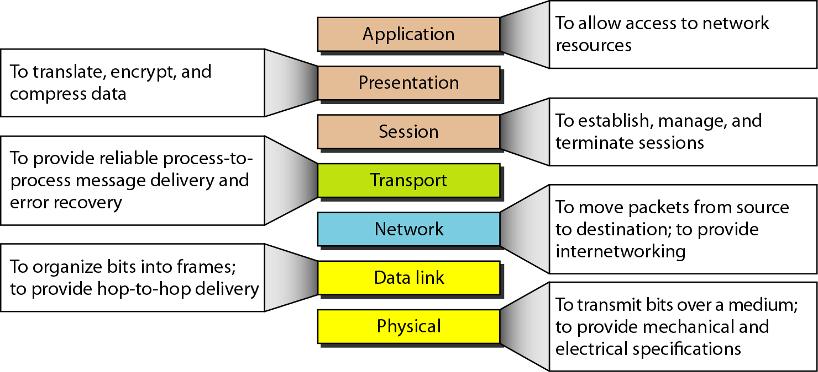
Summary of layers

Slide 12
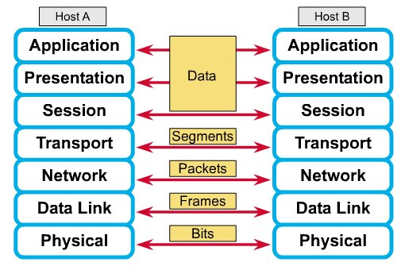
How Does It All Work Together
Each layer contains a Protocol Data Unit (PDU)
PDU’s are used for peer-to-peer contact between corresponding layers.
Data is handled by the top three layers, then Segmented by the Transport layer.
The Network layer places it into packets and the Data Link frames the packets for transmission.
Physical layer converts it to bits and sends it out over the media.
The receiving computer reverses the process using the information contained in the PDU.

Slide 13
The Postal Analogy How would the OSI compare to the regular Post Office
A- Write a 20 page letter to a foreign country.
P- Translate the letter so the receiver can read it.
S- Insure the intended recipient can receive letter.
T- Separate and number pages. Like registered mail, tracks delivery and requests another package if one is “lost” or “damaged” in the mail.
N- Postal Center sorting letters by zip code to route them closer to destination.
D- Local Post Office determining which vehicles to deliver letters.
P- Physical Trucks, Planes, Rail, autos, etc which carry letter between stations.
Application
Presentation
Session
Transport
Network
Data-Link
Physical

Slide 14
TCP/IP PROTOCOL SUITE
The layers in the TCP/IP protocol suite do not exactly match those in the OSI model. The original TCP/IP protocol suite was defined as having four layers: host-to-network, internet, transport, and application. However, when TCP/IP is compared to OSI, we can say that the TCP/IP protocol suite is made of five layers: physical, data link, network, transport, and application.
Layer 4: Application
Layer 3: Transport
Layer 2: Internet
Layer 1: Host to network

Slide 15
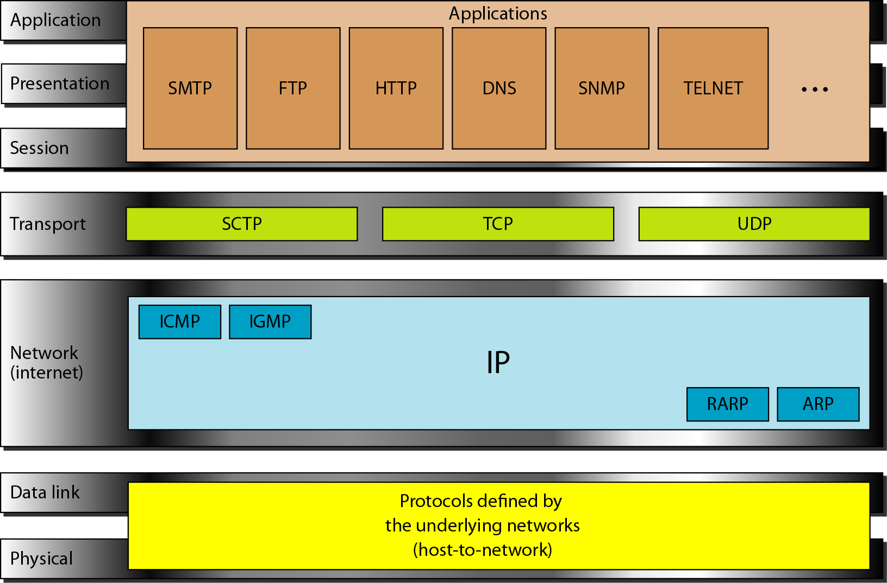
TCP/IP and OSI model

Slide 16
ADDRESSING
Four levels of addresses are used in an internet employing the TCP/IP protocols: physical, logical, port, and specific.

Slide 17
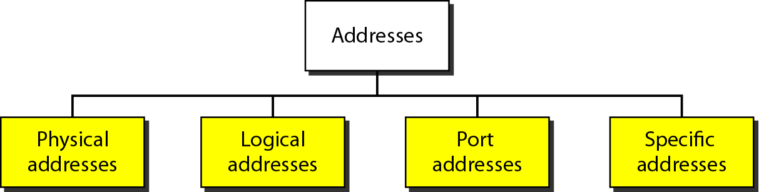
Addresses in TCP/IP

Slide 18
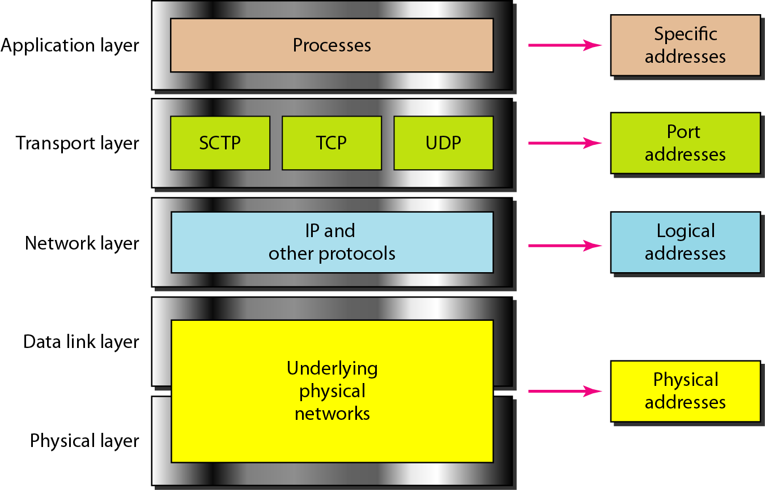
Relationship of layers and addresses in TCP/IP

Slide 19
Example 1
In Figure 1 a node with physical address 10 sends a frame to a node with physical address 87. The two nodes are connected by a link (bus topology LAN). As the figure shows, the computer with physical address 10 is the sender, and the computer with physical address 87 is the receiver.

Slide 20
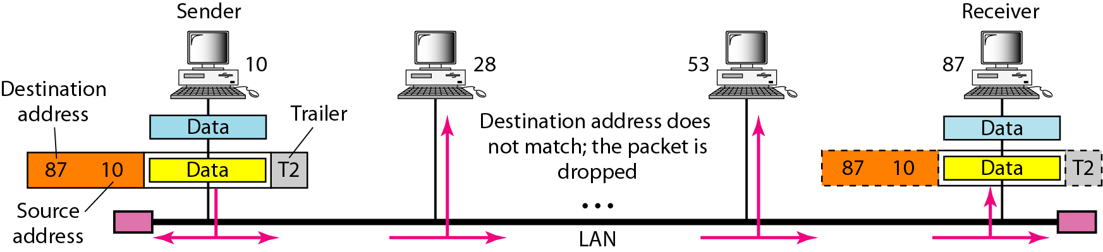
Figure 1 Physical addresses

Slide 21
Example 2
Most local-area networks use a 48-bit (6-byte) physical address written as 12 hexadecimal digits; every byte (2 hexadecimal digits) is separated by a colon, as shown below:
07:01:02:01:2C:4B
A 6-byte (12 hexadecimal digits) physical address.

Slide 22
Example 3
Figure 2 shows a part of an internet with two routers connecting three LANs. Each device (computer or router) has a pair of addresses (logical and physical) for each connection. In this case, each computer is connected to only one link and therefore has only one pair of addresses. Each router, however, is connected to three networks (only two are shown in the figure). So each router has three pairs of addresses, one for each connection.

Slide 23
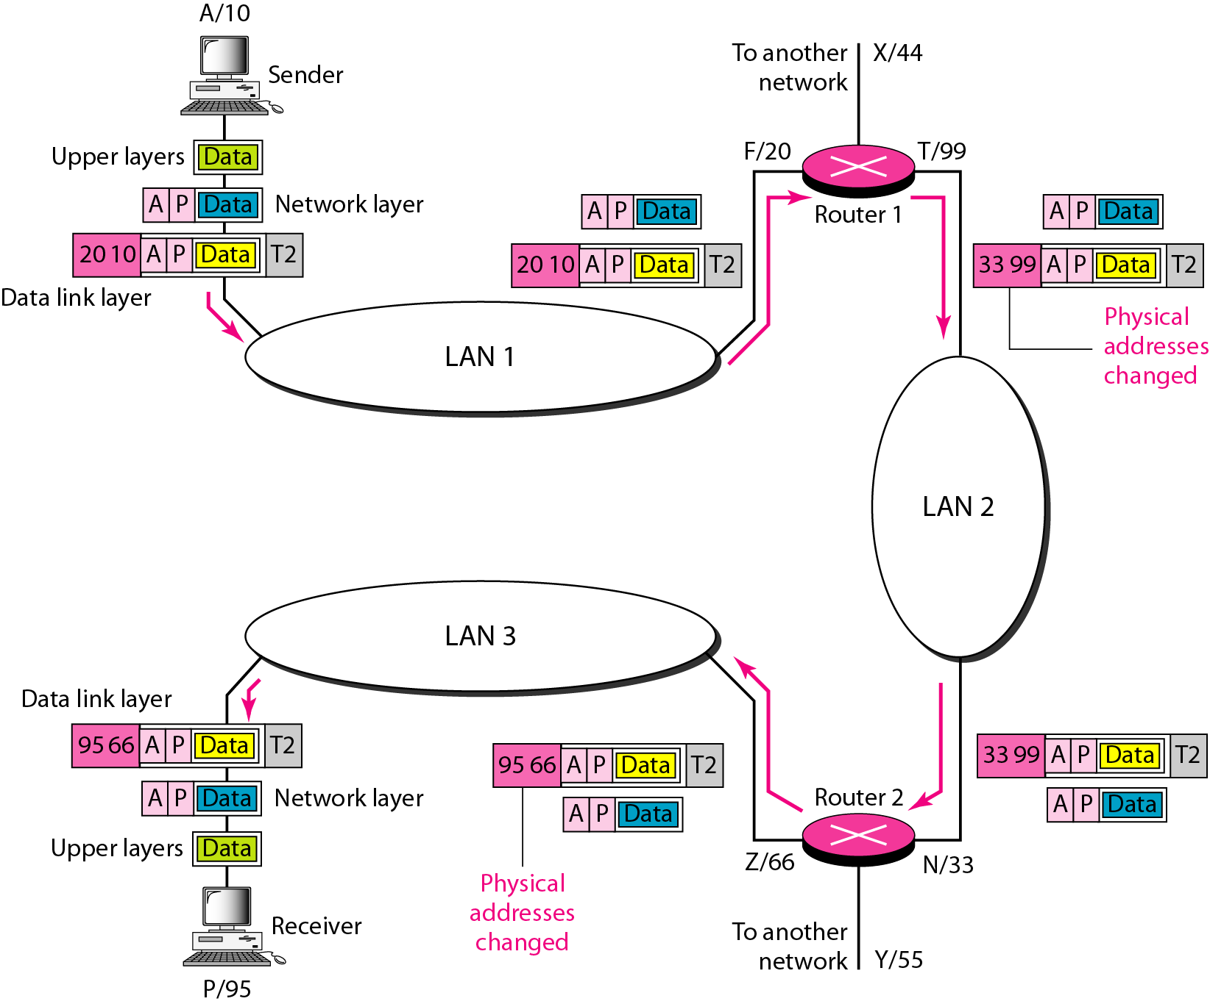
Figure 2 IP addresses

Slide 24
Example 4
Figure 3 shows two computers communicating via the Internet. The sending computer is running three processes at this time with port addresses a, b, and c. The receiving computer is running two processes at this time with port addresses j and k. Process a in the sending computer needs to communicate with process j in the receiving computer. Note that although physical addresses change from hop to hop, logical and port addresses remain the same from the source to destination.

